Slide 1
Log-Linear and Neural Language Models
CS 162: Natural Language Processing
Nanyun (Violet) Peng
Course website: https://vnpeng.net/cs162_win24.html
syllabus,
announcements,
slides,
homeworks
1

Slide 2
Smoothing as Optimization: Conditional Modeling
Given a context x
Which outcomes y are likely in that context?
We need a conditional distribution p(y | x)
p(NextWord=y | PrecedingWords=x)
y is a unigram
x is an (n-1)-gram
Recall: p(Category=y | Text=x)
y ∈ {personal email, work email, spam email}
x ∈ ∑* (it’s a string: the text of the email)
Remember: p can be any function over (x,y)!
Provided that p(y | x) ≥ 0, and ∑_{y} p(y | x) = 1
2

Slide 3
Log-linear Language Models

Slide 4
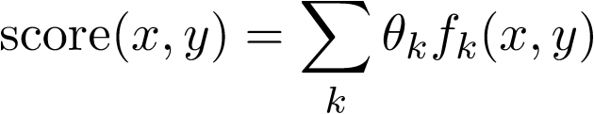
Linear Scoring
We need a conditional distribution p(y | x)
Convert our linear scoring function to this distribution p
Require that p(y | x) ≥ 0, and ∑_{y} p(y | x) = 1; not true of score(x,y)
How well does y go with x?
Simplest option: a linear function of (x,y). Recall logistic regression.
Use “numeric features” that you pick to featurize (x,y).
Then just use a linear function of those numbers.
Weight of feature k
To be learned …
What features can we use?
Whether (x,y) has feature k(0 or 1)
Or how many times it fires (≥ 0)
Or how strongly it fires (real #)
Notes:
Brainstorm features

Slide 5
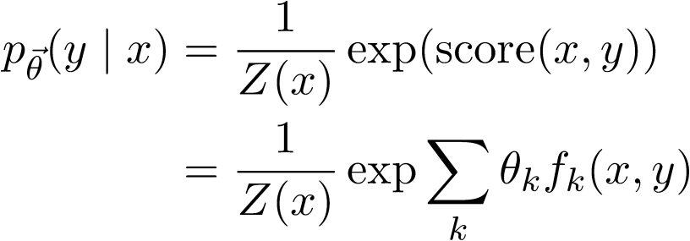

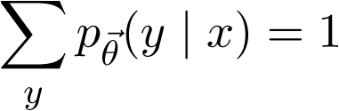
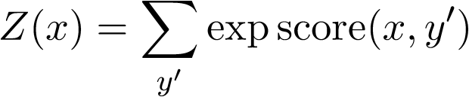
Log-Linear Conditional Probability (interpret score as a log-prob)
unnormalized
prob (at least
it’s positive!)
where we choose Z(x) to ensure that
thus,
sum of unnormalized
probabilities of all the
output candidates y’
Sometimes just written as Z
600.465 - Intro to NLP - J. Eisner
5

Slide 6


Training
n training examples
feature functions f₁, f₂, …
Want to maximize p(training data|θ)
Easier to maximize the log of that:

Slide 7
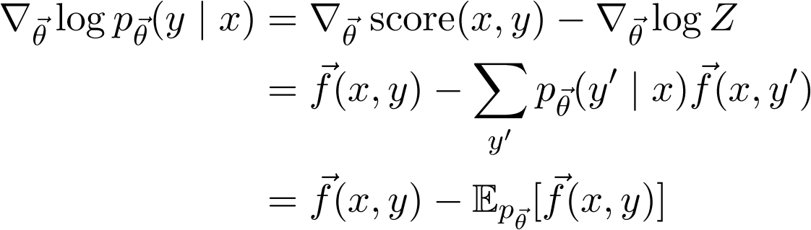
Gradient-based training
Gradually adjust θ in a direction that improves this
The key part of the gradient works out as …
Does this remind you of something we learned before?

Slide 8

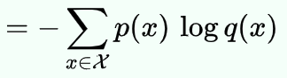
Cross-Entropy Loss vs. Log-Likelihood
Cross-entropy:
In our language models, we model q(y|x), where y denotes the next word (e.g., “baby”), x denotes the context (e.g., “see the”).
We have p(y|x) as the empirical distribution, which means the distribution of the training data. Where p(baby|see the) = 1 and p(other-words | see the) = 0.
As a result, H(p, q) = - log q(y_{i} | x_{i}) ((x_{i ,}y_{i}) denotes a training data point) ➔ negative log-likelihood of the training data!

Slide 9
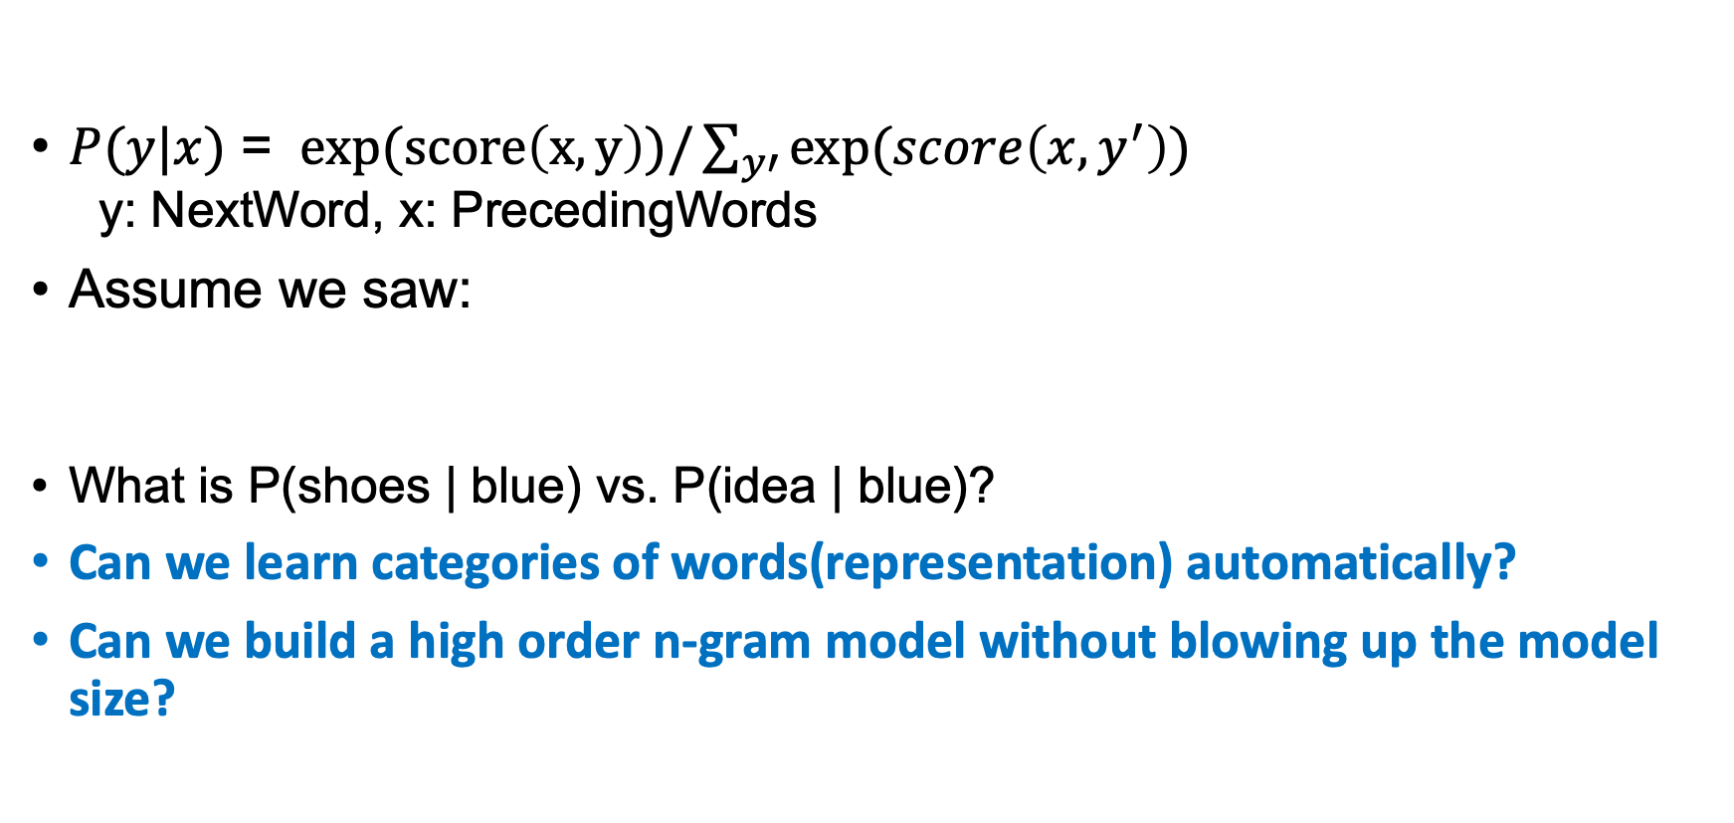
More advanced modeling?
$P(y|x)$ = $exp(score\left(x,y\right))/\sum_{y′}{exp(score\left(x,y^{′}\right))}$ y: NextWord, x: PrecedingWords
Assume we saw:
What is P(shoes | blue) vs. P(idea | blue)?
Can we learn categories of words(representation) automatically?
Can we build a high order n-gram model without blowing up the model size?
red glasses; yellow glasses; green glasses; blue glasses
red shoes; yellow shoes; green shoes;

Slide 10
Neural Language Models

Slide 11
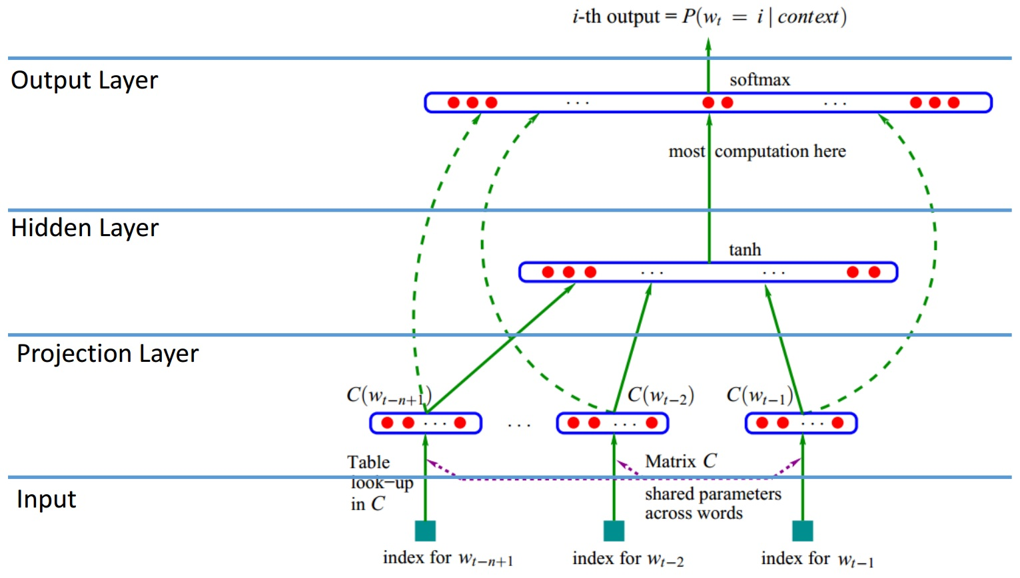

Neural language model
Model $P(y|x)$ with a neural network, where x is the context and y is the next word.
Notes:
A brief introduction

Slide 12
Why?
Potentially generalize to unseen contexts
Example: “the shoes are blue”
This does not occurs in training corpus but
“the glasses are red” does.
If the word representations of “red” and “blue” are similar (and “shoes” and “glasses” are somewhat similar), then the model can generalize.
Why are “red” and “blue” similar?
Because we saw “red skirt”, “blue skirt”, “red pen”, ”blue pen”, etc.

Slide 13
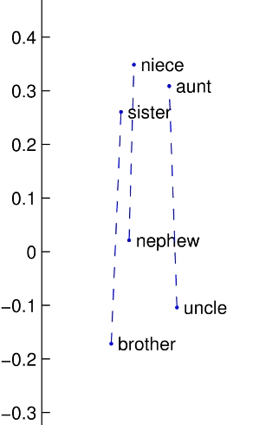
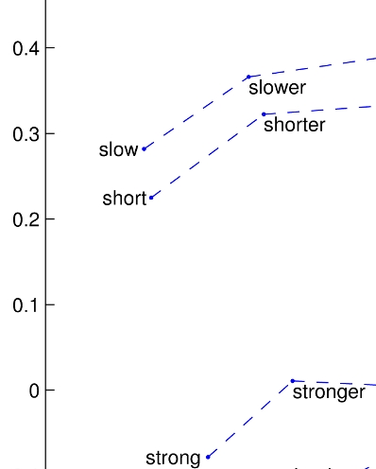
How to model word similarities?
Gender: man -- woman
Syntax: base -- comparative
Word Embeddings!
Picture credit: Pennington et. al. EMNLP 2014

Slide 14
Neural Network Basics

Slide 15
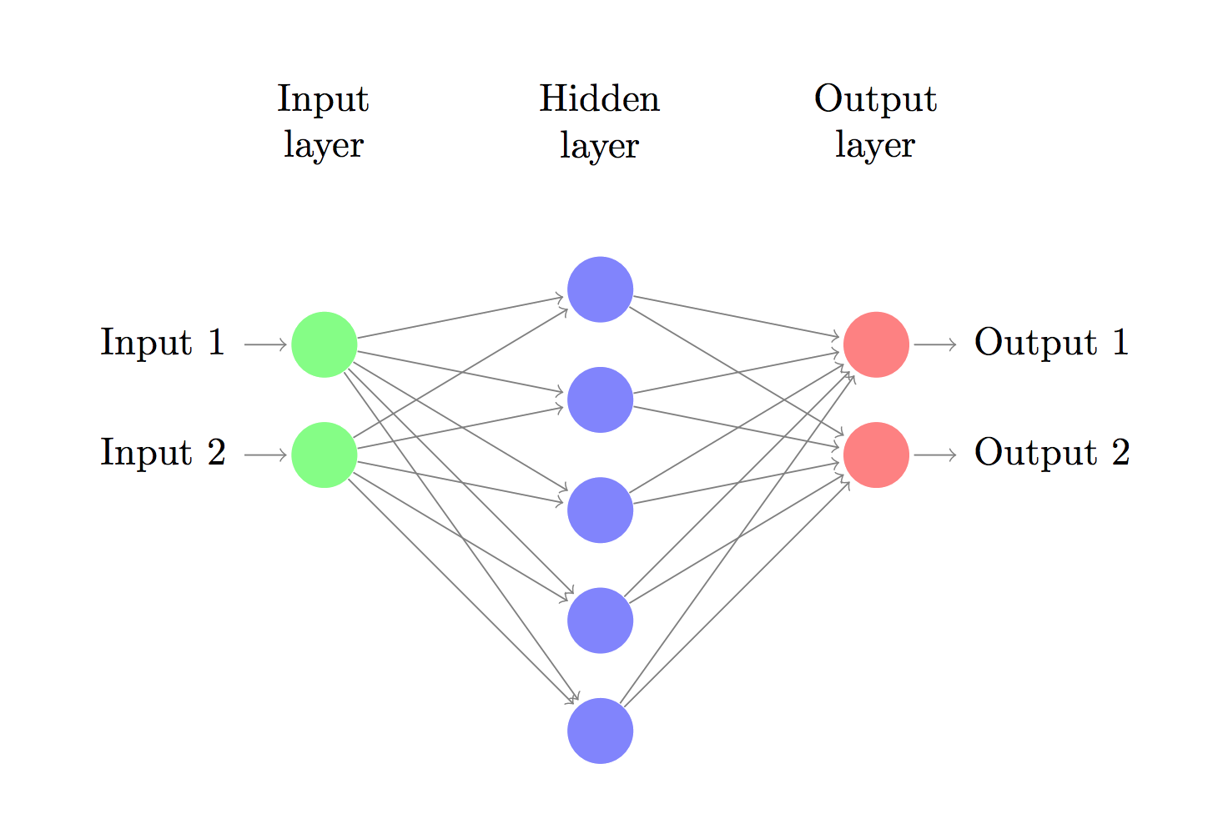
Neural Networks Recap
Let’s consider a 3-layer neural network

Slide 16






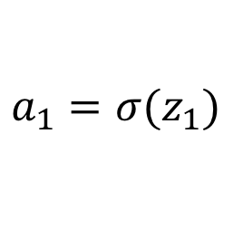




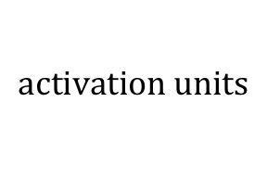
How NN Makes Predictions
forward pass: take input, and produce output
Just a bunch of linear transformation and applying the activation functions to introduce non-linearity
$$z_{1}=xW_{1}+b_{1}$$
$$W_{1}, b_{1}$$
$$W_{2}, b_{2}$$
$$a_{1}=σ⁡(z_{1})$$
$$z_{2}=a_{1}W_{2}+b_{2}$$
$$input, x$$
$$output, \hat{y}$$
$$a_{2}= \hat{y}=softmax(z_{2})$$
$$z_{1}$$
$$a_{1}$$
$$z_{2}$$
$$activation units$$
Notes:
Sigmoid, tanh, relu

Slide 17
Learning the Parameters
Find parameters that minimize the loss (or maximizes the likelihood) of the training data L(x, y).
How to minimize the loss function?
Gradient Descent – batch or mini batch or stochastic!
We need gradients of the loss function with respect to the parameters – what are our parameters?
How to compute the gradients of the parameters?
Backpropagation algorithm!

Slide 18
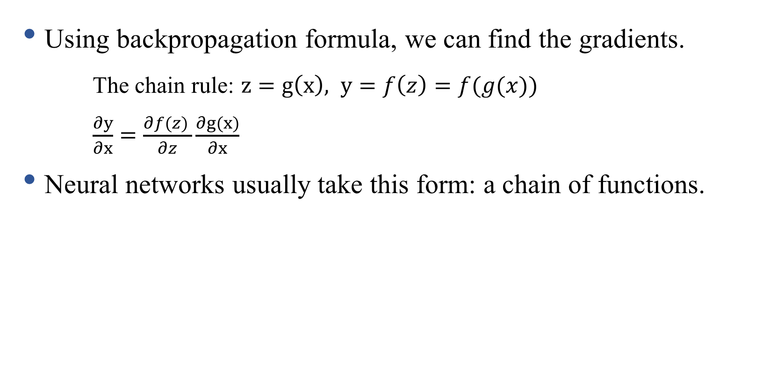
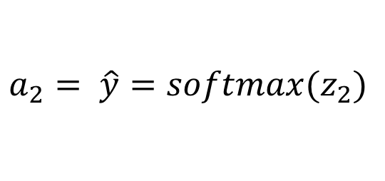

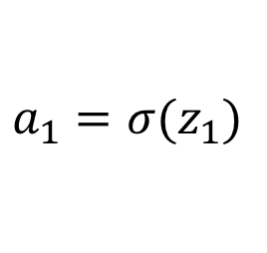

Backpropagation
Using backpropagation formula, we can find the gradients.
The chain rule: $z=g\left(x\right), y=f\left(z\right)=f(g(x))$
$\frac{∂y}{∂x}=\frac{∂f(z) }{∂z}\frac{∂g(x)}{∂x}$
Neural networks usually take this form: a chain of functions.
$$z_{1}=xW_{1}+b_{1}$$
$$a_{1}=σ⁡(z_{1})$$
$$z_{2}=a_{1}W_{2}+b_{2}$$
$$a_{2}= \hat{y}=softmax(z_{2})$$

Slide 19

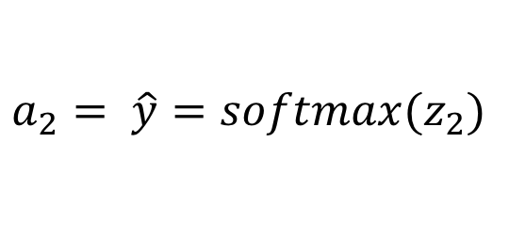


Recipe for Backpropagation
Identify intermediate functions
Compute local gradients
Combine with upstream error signal to get full gradient
$$z_{1}=xW_{1}+b_{1}$$
$$W_{1}, b_{1}$$
$$W_{2}, b_{2}$$
$$a_{1}=σ⁡(z_{1})$$
$$z_{2}=a_{1}W_{2}+b_{2}$$
$$input, x$$
$$output, \hat{y}$$
$$a_{2}= \hat{y}=softmax(z_{2})$$
$$z_{1}$$
$$a_{1}$$
$$activation units$$

Slide 20
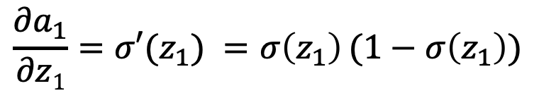
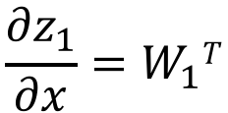
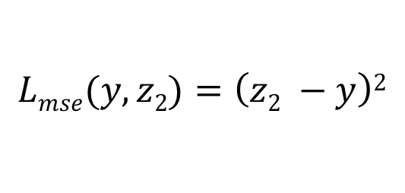
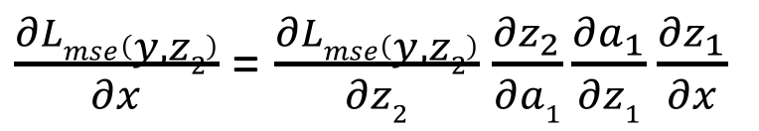
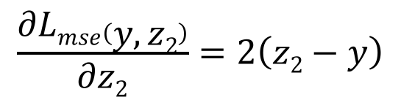
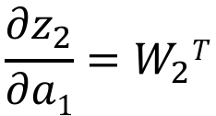
Intermediate Variables (forward propagation)
Intermediate Gradients (backward propagation)
$$z_{1}=xW_{1}+b_{1}$$
$$\frac{{∂z}_{1}}{∂x}=W_{1}T$$
$$\frac{{∂a}_{1}}{∂z1}=σ′(z_{1}) =σ\left(z_{1}\right)(1−σ\left(z_{1}\right))$$
$$a_{1}=σ⁡(z_{1})$$
$$\frac{{∂z}_{2}}{∂a1}=W_{2}T$$
$$z_{2}=a_{1}W_{2}+b_{2}$$
$$Lmse(y,z2)=\left(z2 −y\right)2$$
$$\frac{∂Lmse\left(y, z2\right)}{∂z2}=2\left(z2−y\right)$$
$\frac{∂Lmse\left(y, z2\right)}{∂x}$ = $\frac{∂Lmse\left(y, z2\right)}{∂z2}$ $\frac{{∂z}_{2}}{∂a1}\frac{{∂a}_{1}}{∂z1}\frac{{∂z}_{1}}{∂x}$

Slide 21

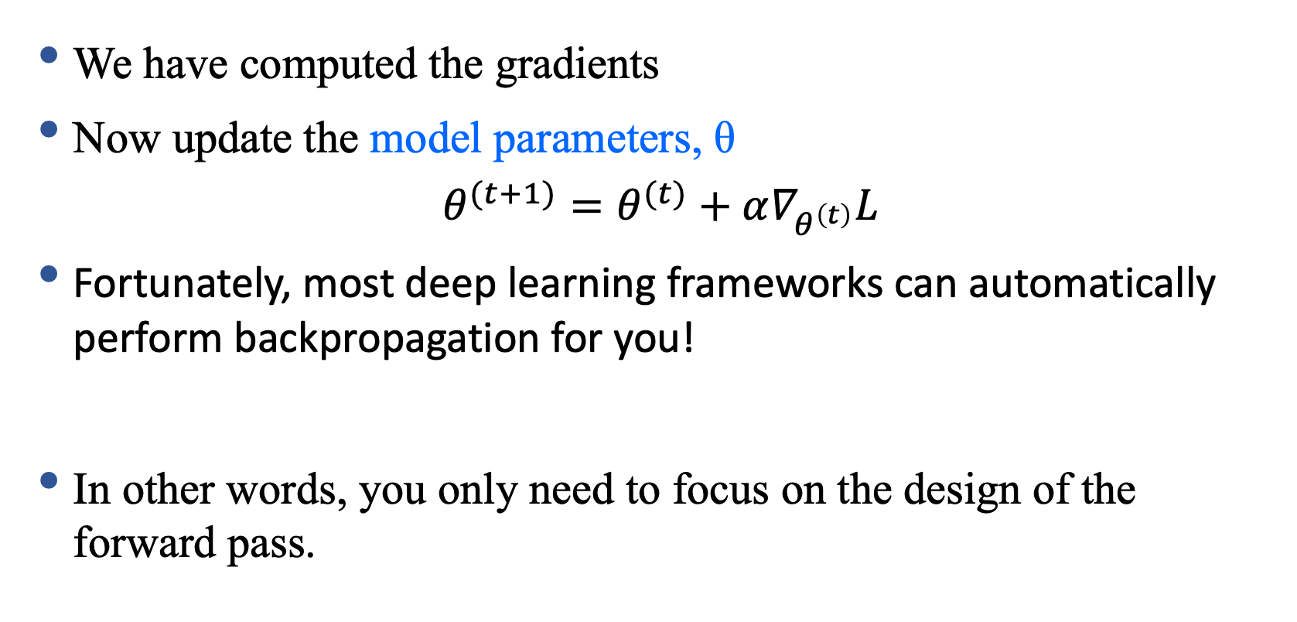
Update the Parameters
We have computed the gradients
Now update the model parameters, θ
$$θ^{(t+1)}=θ^{(t)}+α∇_{θ^{\left(t\right)}}L$$
Fortunately, most deep learning frameworks can automatically perform backpropagation for you!
In other words, you only need to focus on the design of the forward pass.

Slide 22

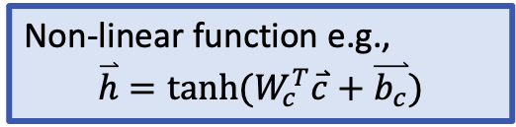
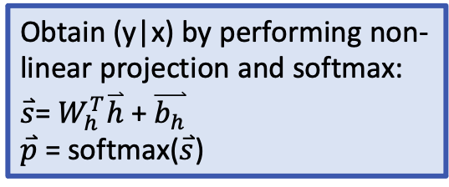
Feedforward Neural language model
Model $P(y|x)$ with a neural network
Obtain (y|x) by performing non-linear projection and softmax:
$\overset{⃑}{s}$= $W_{h}^{T}\overset{⃑}{h}$ + $\overset{⃑}{b_{h}}$
$\overset{⃑}{p}$ = softmax($\overset{⃑}{s}$)
Y. Bengio et al., JMLR’03
Non-linear function e.g.,
$$\overset{⃑}{h}=tanh⁡(W_{c}^{T}\overset{⃑}{c}+\overset{⃑}{b_{c}})$$
Concatenate projected vectors to get multi-word contexts.
Word representations to project inputs into low-dimensional vectors

Slide 23
Remember word embeddings?
Word tokens map to vectors in a low-dimensional space
Conditional word probabilities are produced by neural network models on vectors of word embeddings
Vector-space representation enables semantic/syntactic similarity between words/sentences
Use cosine similarity can measure word similarity
Find nearest neighbours: synonyms, antonyms
Algebra on words: {king} – {man} + {woman} = {queen}

Slide 24
Vector-space representation of words
“One-hot” of “one-of-V” representation of a word token at position t in the text corpus, with vocabulary of size V
1
Vector-space representation of the prediction of target word w_{t} (we predict a vector of size D)
ẑ_{t}
v
V
_{Ct-1}
Vector-space representation of any word v in the vocabulary using a vector of dimension D
_{Cv}
1
Vector-space representation of the t^{th} word’s history: e.g., concatenation of n-1 vectors of size D
_{Ct-2}
D
_{Ct-1}

Slide 25
Learning continuous space language models
Input:
word history (vector representation)
Output:
target word (vector representation)
Function that approximates the conditional word likelihood p(x_{t} | x_{1:t-1}):
Similar: skip-gram
Feed-forward neural network
Recurrent neural network
…

Slide 26
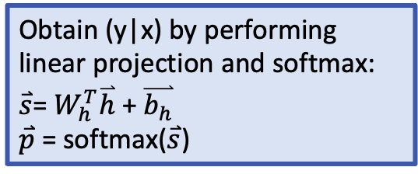
Feedforward Neural language model
Model $P(y|x)$ with a neural network
Obtain (y|x) by performing linear projection and softmax:
$\overset{⃑}{s}$= $W_{h}^{T}\overset{⃑}{h}$ + $\overset{⃑}{b_{h}}$
$\overset{⃑}{p}$ = softmax($\overset{⃑}{s}$)
Y. Bengio et al., JMLR’03
Non-linear function e.g.,
$$\overset{⃑}{h}=tanh⁡(W_{c}^{T}\overset{⃑}{c}+\overset{⃑}{b_{c}})$$
Concatenate projected vectors to get multi-word contexts.
Word representations to project inputs into low-dimentional vectors

Slide 27
Learning continuous space language models
How do we learn the word representations for each word in the vocabulary?
How do we learn the model that predicts the next word or its representation ẑ_{t} given a word history?
Simultaneous learning of model and representation
What are the parameters of the model?

Slide 28
Objective function
likelihood:
Objective function to maximize:
Log-likelihood
In general, the objective function is defined as: score of the right answer – a normalization term

Slide 29
Learning neural language models
Maximize the log-likelihood (minimize the negative log-likelihood) of observed data, w.r.t. parameters θ of the neural language model
Parameters θ in a feedforward neural language model:
Word embedding matrix E (some variation: bias b_{v})
Neural network weights: W_{c}, b_{c} , W_{h}, b_{h},
Gradient descent with learning rate η:

Slide 30
Optimize the objective function
Gradient of log-likelihood w.r.t. parameters θ:
Use the chain rule to compute the gradients
In practice, current deep learning frameworks automatically perform backpropagation for you
Notes:
The s is a neural architecture.

Slide 31
Limitation of the Feedforward Neural Language Model
Sparsity – Solved
Word Similarity – Solved
Finite/fixed Context – Not solved yet
Next time:
RNN language models

